Slide 1
Applied
Data
Science II
Week 6: Lions, Tigers, and Splines - oh my!
Kyle Scot Shank
WI-22

Slide 2
6:00 - 6:30 HW + CHECK-IN
6:30-7:30 TOPICS + CODE!
7:30-7:45
SNACK BREAK!
7:45 - 9:00 HANDs-ON CODE LAB
Let’s walk through it!
Let’s pump up our power with some additive models and other kinds of neat stuff! !
Time for some munchies
Work through stuff together

Slide 3
CHECK-IN

Slide 4
CHECKINg IN!
How are we feeling?
What do we want to do about class on Tuesday the 22nd?
Final Project Discussion

Slide 5
HW REVIEW

Slide 6
TOPIC OVERVIEW
Moving beyond linear models!

Slide 7
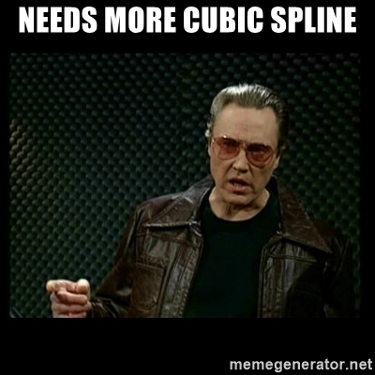
MOVING BEYOND LINEAR MODELS
Remember those near linear models?
What’s one of their drawbacks?

Slide 8
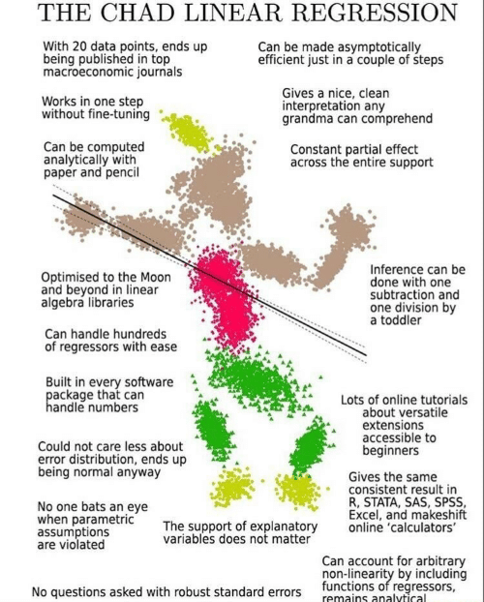
MOVING BEYOND LINEAR MODELS
The truth is never linear!
….Or almost never!
But often the linearity assumption is good enough.
When its not . . .
Polynomials
step function
Splines
local regression
And generalized additive models offer a lot of flexibility, without losing the ease and interpretability of linear models.

Slide 9
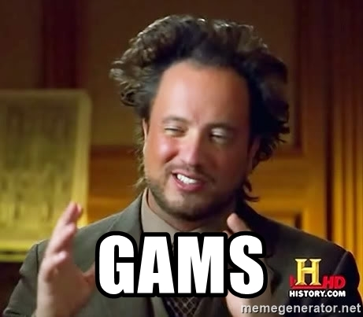
MOVING BEYOND LINEAR MODELS
We’re going to focus on just two of these as being specifically helpful:
Spline functions + Generalized Additive Models (GAMS)

Slide 10
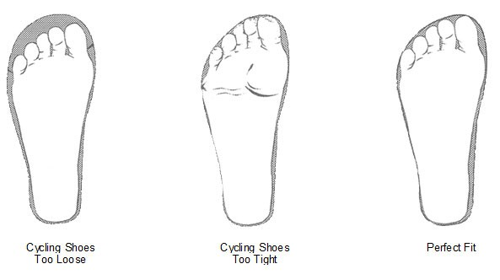
Splines!
Let’s start from the beginning: what in the world is a spline?
Let’s us an analogy of fitting a new shoe. What we’ve done up until this point has been fitting a foot to a specific shoe (linear models, lasso, etc.) - this let’s us approximate stuff really well.
What splines do is fit the shoe to a specific foot.

Slide 11
Splines!
This works by using things called piecewise polynomial functions.
Think of this as similar to what you do in Powerpoint when you try to use that nifty Line tool - each time you click and add a new segment, you introduce a new inflection point (or “knot”) in the data.
This lets you build arbitrarily “curvy” lines to fit our data!

Slide 12
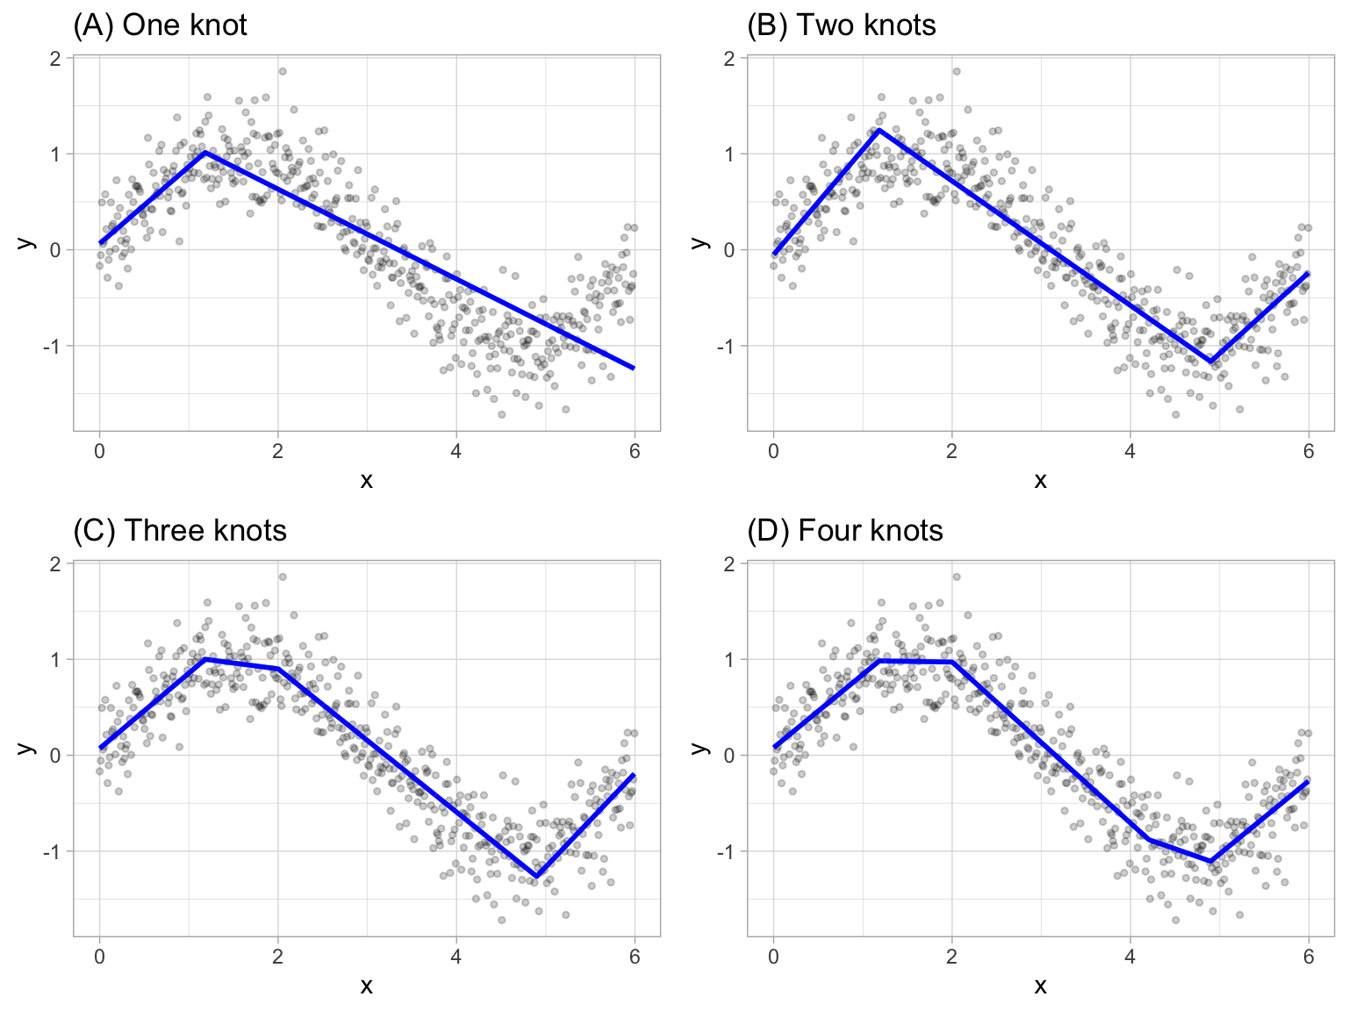
Splines!
How do they work?
Spline Regression is a non-parametric regression technique. In this technique the dataset is divided into bins at intervals or points which we call knots.
The data between knots each get a separately fit piecewise polynomial, which are then combined. This is called interpolation (we can just call it “smoothing”).
In other words, splines are series of polynomial segments strung together, joining at knots.

Slide 13
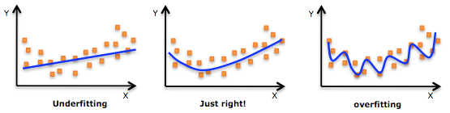
Splines!
How do you, uh, pick the right number and location for the knots?
If you have the time + domain knowledge, you can do this manually!
But you shouldn’t, because we’re dumb and slow monkeys.
You can provide the desired degrees of freedom (which equals the number of knots) and the computer can partition the data equally.
OR - we can use cross-validation to understand the optimal value!

Slide 14

K-FOLD CROSS VALIDATION
Let’s do this together!
Open up R!

Slide 15
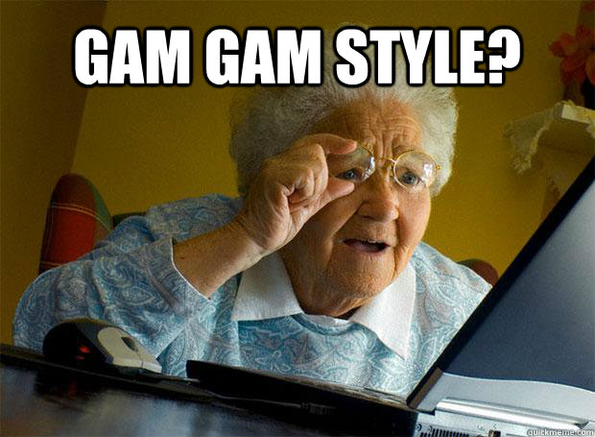
GENERALIZED ADDITIVE MODELS
Get a bunch of data scientists into a room and ask them if they’ve used a Random Forest model and you’ll get a sea of smiles and maybe a bunch of nerdy arguments.
Ask them if they’ve used a GAM - and all you’ll hear is crickets.
That is, until you - the incredibly savvy and VERY smart APPLIED data scientist, grab their laptop and show them what they’ve been missing out on.

Slide 16
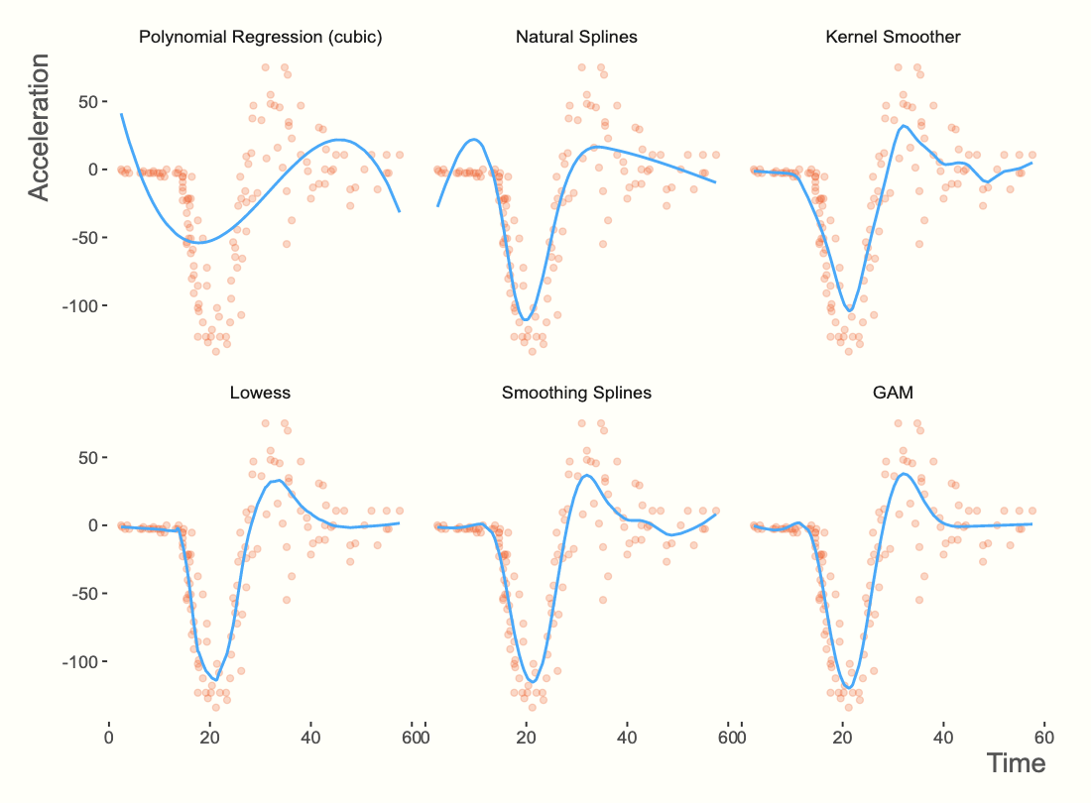
GENERALIZED ADDITIVE MODELS
GAMs relax the restriction that the relationship must be a simple weighted sum, and instead assume that the outcome can be modelled by a sum of arbitrary functions of each feature.
To do this, we simply replace beta coefficients from a Linear Regression with a flexible function which allows nonlinear relationships (we’ll look at the maths later).
This mysterious flexible function is called a (surprise!) spline.

Slide 17
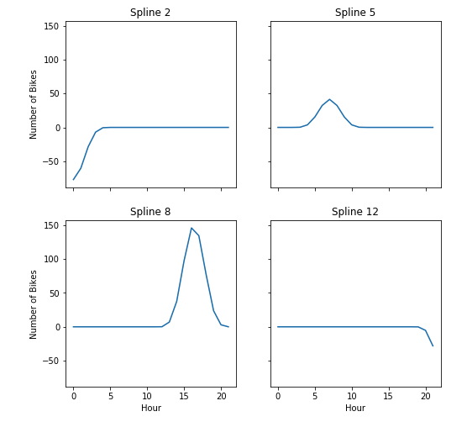


GENERALIZED ADDITIVE MODELS
How do they work?
The math here can get pretty gnarly, pretty quickly, but this is the high-level answer:
In a normal linear regression, we have something like
In a GAM model we replace the beta coefficients with s, which is a shorthand for an individual spline
This lets us build really complicated models that can best fit our data.

Slide 18
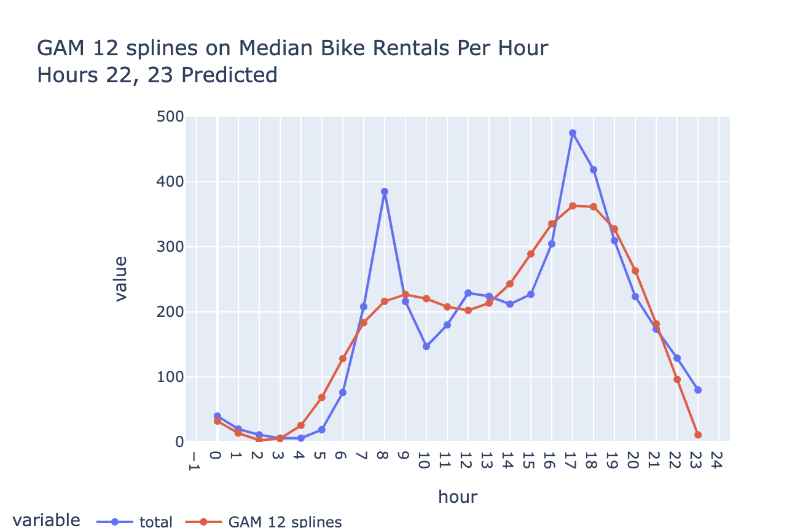
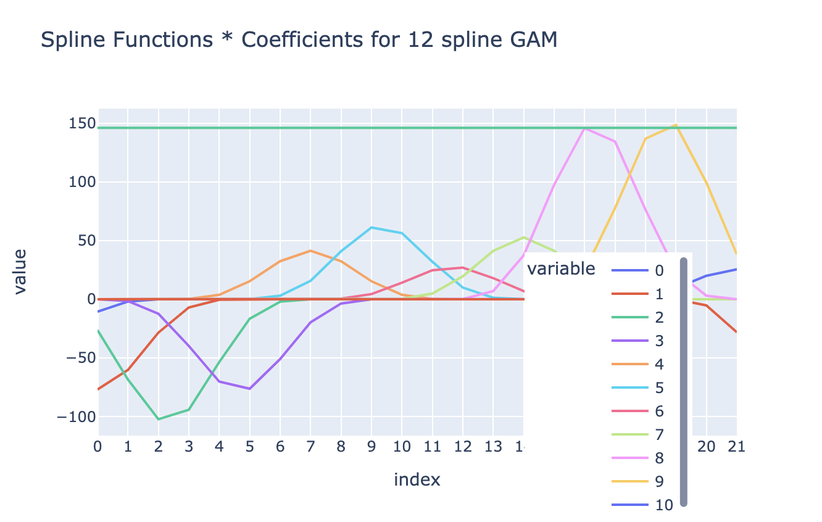
GENERALIZED ADDITIVE MODELS
How do they work?
When we’ve identified which Spline equations we’re going to use for each variable, we can then simply add them up and this gives us the final estimate for our equation at each point in space.

Slide 19
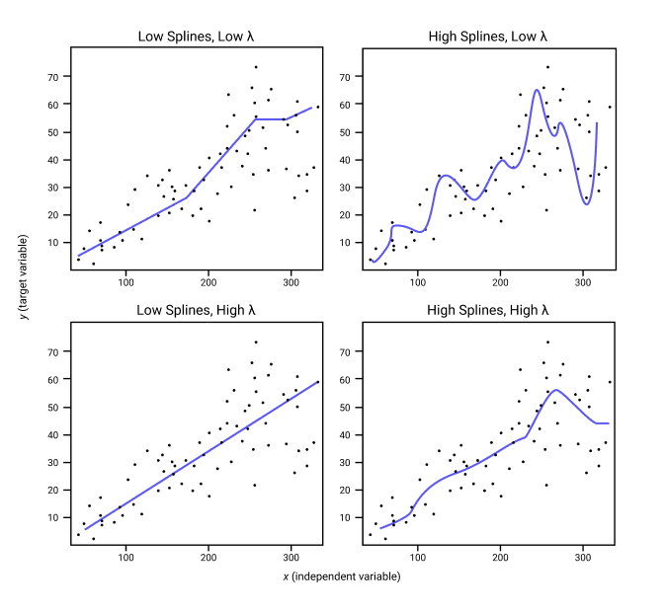
GENERALIZED ADDITIVE MODELS
Why use these?
Interpretability
When a regression model is additive, the interpretation of the marginal impact of a single variable (the partial derivative) does not depend on the values of the other variables in the model.
Flexibility
GAMs tend to capture nonlinear effects that other models miss
Regularization
We control wiggliness (a technical term!) which is related to some very serious statistics and helps with the bias/variance trade-off.

Slide 20
K-nearest neighbors
Let’s do this together!
Open up R!

Slide 21
SNACK BREAK!
Come back in 15!

Slide 22
CODE LAB!
Open up rstudio

